Slide 1
Replication Study of “The Adverse Effects of Sunshine: A Field Experiment on Legislative Transparency in an Authoritarian Assembly”
Zeren Li and Mitch Watkins
PS750: Political Economy of Development

Slide 2
Roadmap
Introduction
Data and Method
Results
Extension
Discussion

Slide 3
Research Question
What’s the impact of transparency on legislative responsiveness in an authoritarian assembly?
Evidence shows that transparency matters for responsiveness both in developed (Alt, Lassen, and Skilling 2002) and developing countries (Besley and Burgess 2002; Besley, Pande, and Rao 2006; Brunetti and Weder 2003).
Incentive Effect: delegates change behavior in response to transparency
Selection Effect: voters replace a delegate with someone more likely to act in their interest

Slide 4
Theory
However, legislators in authoritarian systems serve a different role as those in electoral democracies
Transparency in authoritarian assemblies may have two contradictory effects:
Tone down illicit bargains and political self-dealing by exposing these activities to the public
To sanction the behavior of legislators could actually curtail other forms of participation that have been shown to be associated with regime survival.
They address this puzzle with a randomized experiment that tests the effect of transparency on the behavior of 463 delegates in the National Assembly of the single-party state of Vietnam (or VNA).

Slide 5
Hypotheses
The adverse consequences hypothesis: Transparency will lead to a reduction in the amount of critical activities engaged in by delegates.
The non-sensitive effort hypothesis: Transparency will increase the amount of visible effort by legislators in nonsensitive activities.
The return to salience: In the presence of transparency, delegates who remain silence and do not engage in sensitive activity will be rewarded by the leadership. Delegates who do otherwise will be punished.
The return to non-sensitiveness: In the presence of transparency, delegates who display effort in non-sensitive activities will be rewarded by the leadership. Delegates who do otherwise will be punished.
Notes:
We will focus on the first 2 hypotheses in our replication.

Slide 6
Experimental Design
Time period: 2007- 2010, six sessions of the VNA
Intervention: Randomly selected 144 out of 493 delegates in the VNA to inform citizens daily about these delegates’ legislative activities on VietnamNet
introduced two delegates each day on their political homepage and launched their individual web sites.
Later reported legislative performance
legislative speeches and queries
queries that were critical of government policies
queries were relevant to the interests of the delegate’s constituents, province, and profession
a comparison of the delegates’ performance on these indicators with the highest, average, and lowest delegates.

Slide 7
Data and Methods
Method: Difference-in-Difference
Dependent Variables: Questions asked by a delegate (#), Percent of questions critical of ministers, ministries, or govt (%)
Treatment: Coverage on VietnamNet
Treatment period: Sixth VNA session (2010)
Interaction term (treatment intensity): Provincial-level internet penetration rate
Controls
Personal characteristics: centrally nominated, full time, retirement
Provincial social-economic indicators: GDP, pop, urbanization, souther province, govt transfers/GDP, college students

Slide 8
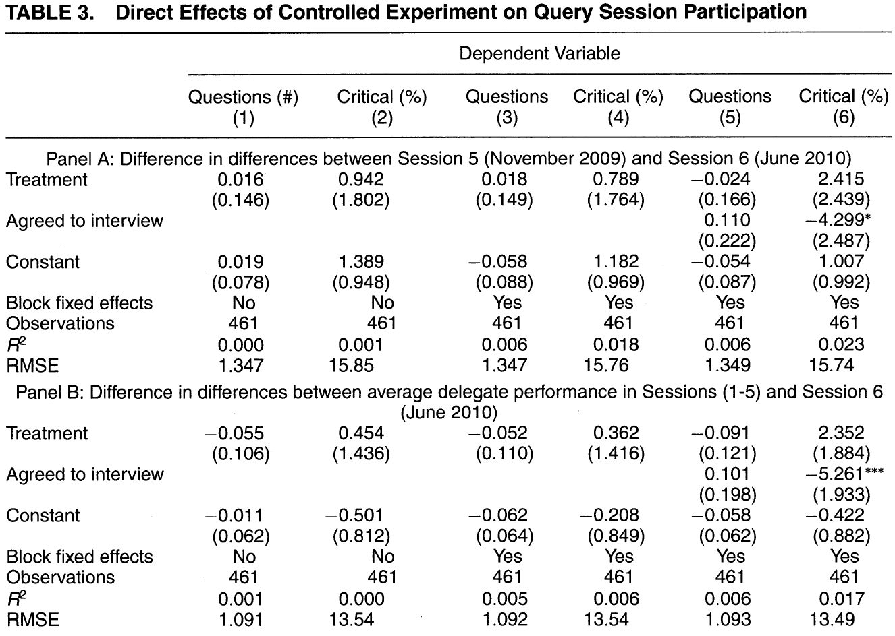
Replication of direct results
Notes:
No significant direct results; inconsistent signs on treatment

Slide 9
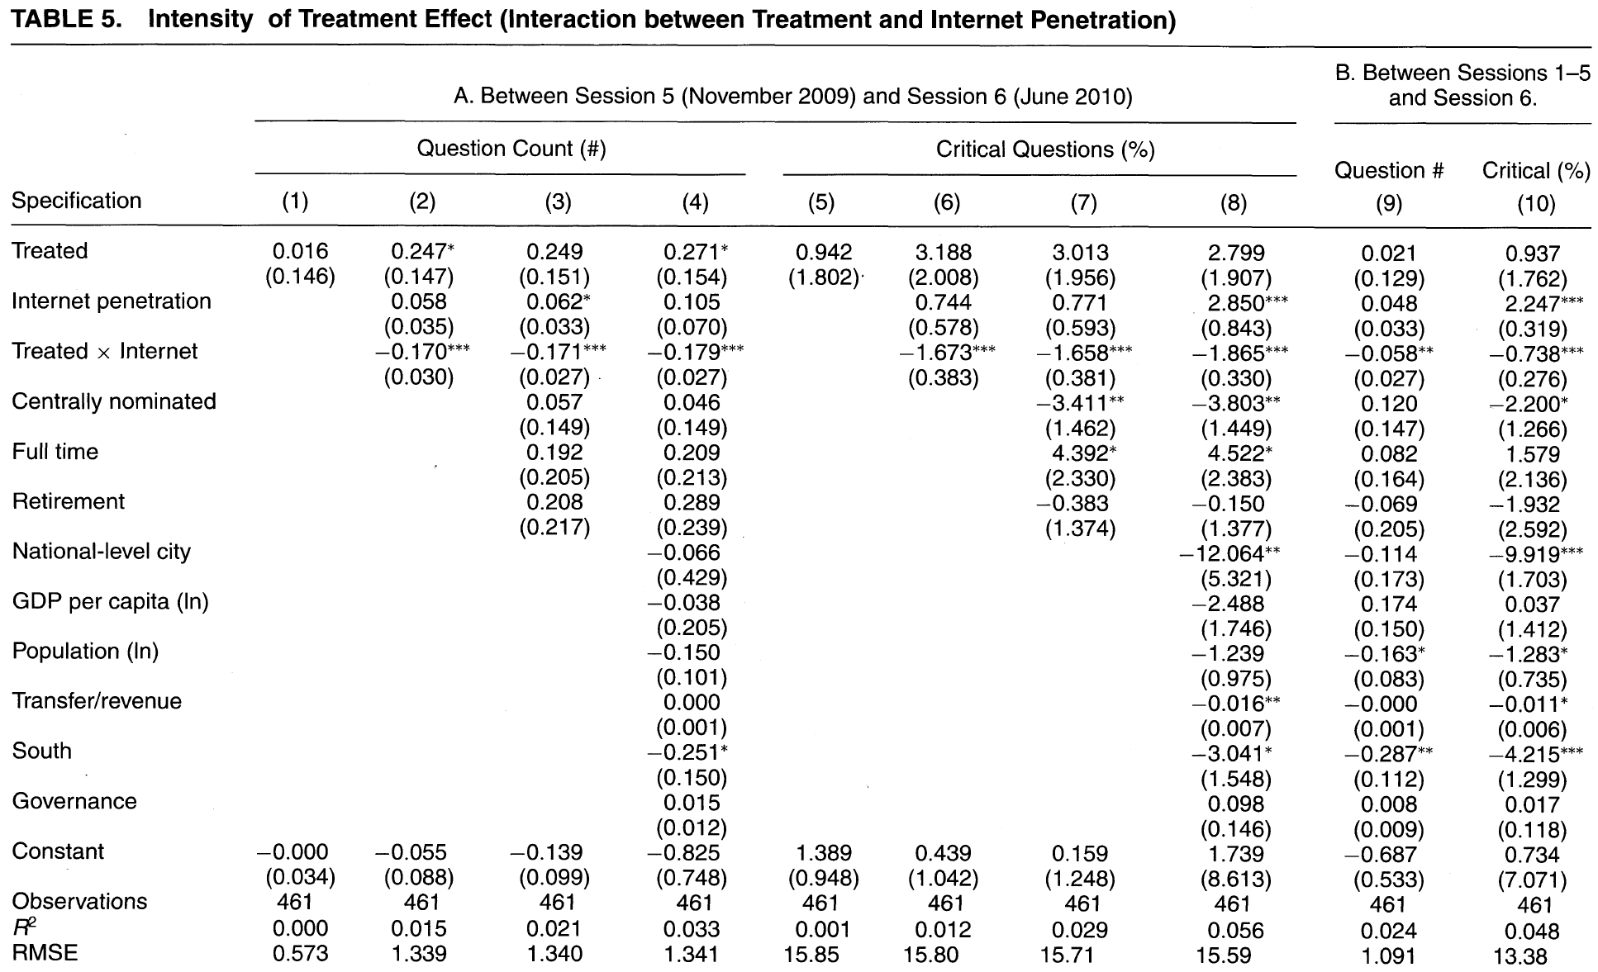
Notes:
Negative finding on interaction term with internet penetration

Slide 10
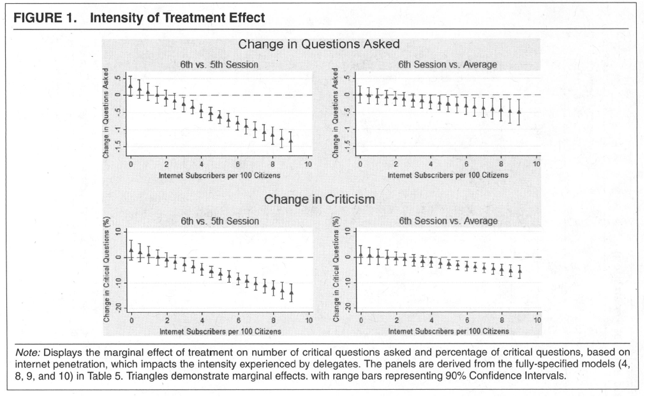

Slide 11
Extensions
Analysis of treatment intensity variable
Distribution of the internet penetration and the number of delegates
Outlier Analysis: Cook-D analysis and dfbeta
Drop the outliers and re-run the regression
Check the pre-trend relationship between internet penetration and participation and criticism for the treatment and control groups

Slide 12
Distribution of the Internet Penetration

Slide 13
Marginal Plots with the Distribution
Notes:
Roughly 80% of delegates in the internet range for which the model predicts a positive effect of treatment. For diff-in-diff for session 6 vs. session 5, only 3 provinces (Hanoi, Ho Chi Ming City, and Da Nang) have statistically significant negative coefficients.

Slide 14
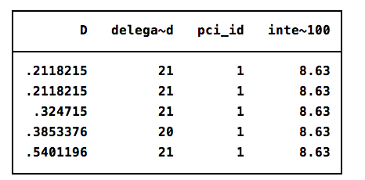
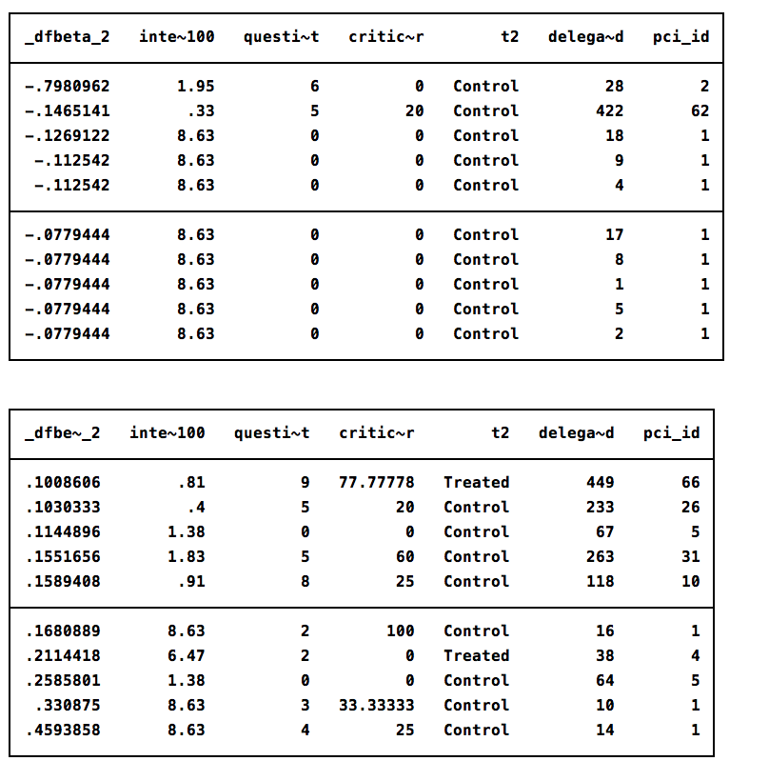
Outlier Analysis
Delegates in Province 1 (Hanoi) are influential observations.
Notes:
Province 1 (Hanoi) has a strong influence on the results.

Slide 15
Rerun primary result without outliers
 | TABLE5 |  |  |  | Drop if Internet penetration >4
VARIABLES | Question Count | Critical Questions | Question Count between Sessions 1–5 & Session 6. | Question Count between Sessions 1–5 & Session 6. | Question Count | Critical Questions | Question Count between Sessions 1–5 & Session 6. | Question Count between Sessions 1–5 & Session 6.
Treated | 0.271* | 2.799 | 0.021 | 0.937 | 0.221 | 2.362 | 0.138 | 1.825
 | (0.154) | (1.907) | (0.129) | (1.762) | (0.216) | (2.642) | (0.188) | (2.501)
Internet penetration | 0.105 | 2.850*** | 0.048 | 2.247*** | 0.508** | 1.363 | 0.227 | 0.729
 | (0.070) | (0.843) | (0.033) | (0.319) | (0.231) | (2.269) | (0.178) | (2.634)
Treated × Internet | -0.179*** | -1.865*** | -0.058** | -0.738*** | -0.112 | -1.225 | -0.252 | -2.103
 | (0.027) | (0.330) | (0.027) | (0.276) | (0.240) | (2.471) | (0.247) | (2.629)
Controls | Y | Y | Y | Y | Y | Y | Y | Y
Observations | 461 | 461 | 461 | 461 | 415 | 415 | 461 | 461
R-squared | 0.033 | 0.056 | 0.024 | 0.048 | 0.031 | 0.042 | 0.024 | 0.048
Notes:
In our replication files, we found insignificant results on interaction term by excluding province 1 (Hanoi).

Slide 16
Pre-treatment trends in relationship between participation and internet penetration
Notes:
Anderson (2013)

Slide 17
Post-treatment trends in relationship

Slide 18
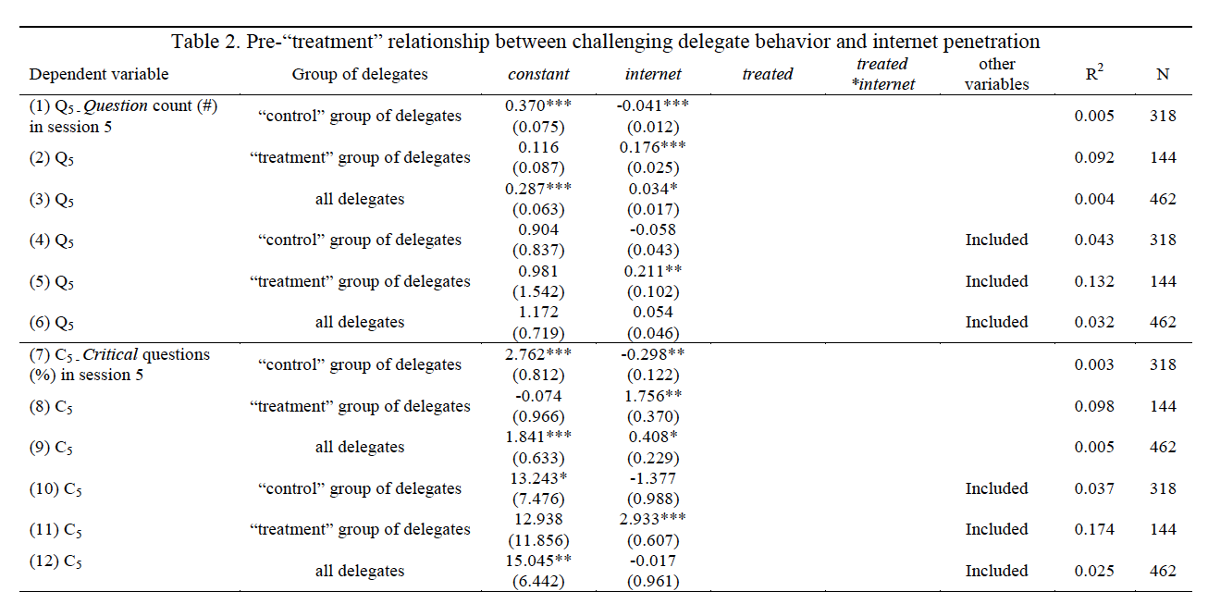
Andersen (2013)
Replication of table found in .do file.

Slide 19
Additional concerns
Additional intensity variables used in robustness checks in article appendix have a similar distribution as internet penetration
Urbanization and student share of population
Dependent variable data on participation has a zero-heavy distribution
Roughly 80-90 percent of delegates do not ever speak or criticism in sessions 5 or 6
Small number of delegates can have substantial effect on results
Appropriateness of OLS?

Slide 20
Reference
Malesky, E., Schuler, P., & Tran, A. (2012). The adverse effects of sunshine: a field experiment on legislative transparency in an authoritarian assembly. American Political Science Review, 106(04), 762-786.
Anderson, James H., Sunshine Works -- Comment On "The Adverse Effects of Sunshine: A Field Experiment on Legislative Transparency in an Authoritarian Assembly" (September 1, 2013). World Bank Policy Research Working Paper No. 6602.

Slide 21
Appendix slides
Balance statistics
Table 3: ATE
Original treatment intensity figures

Slide 22
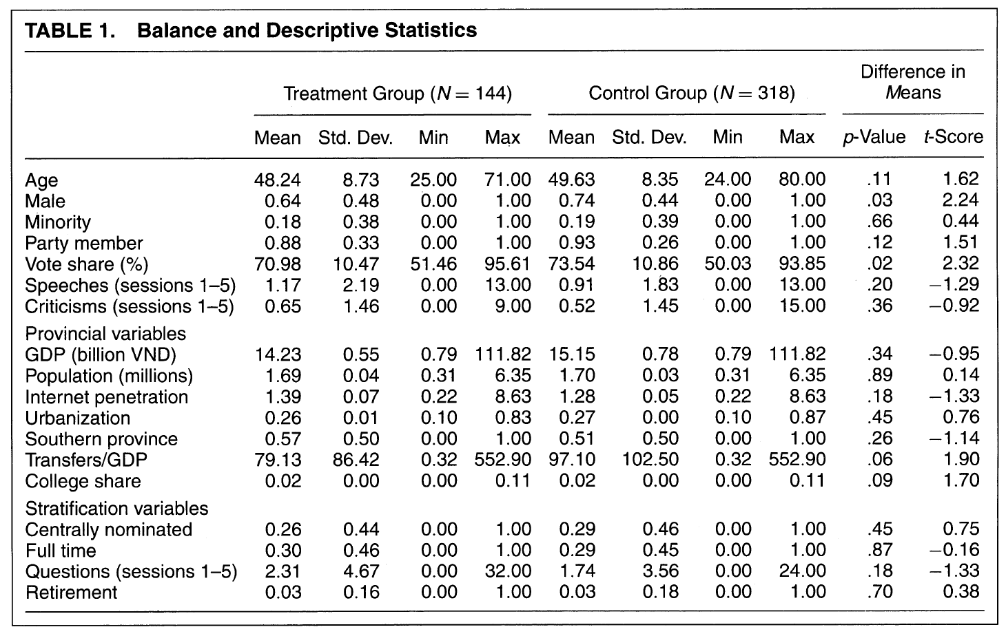
Summary Stats

Slide 23
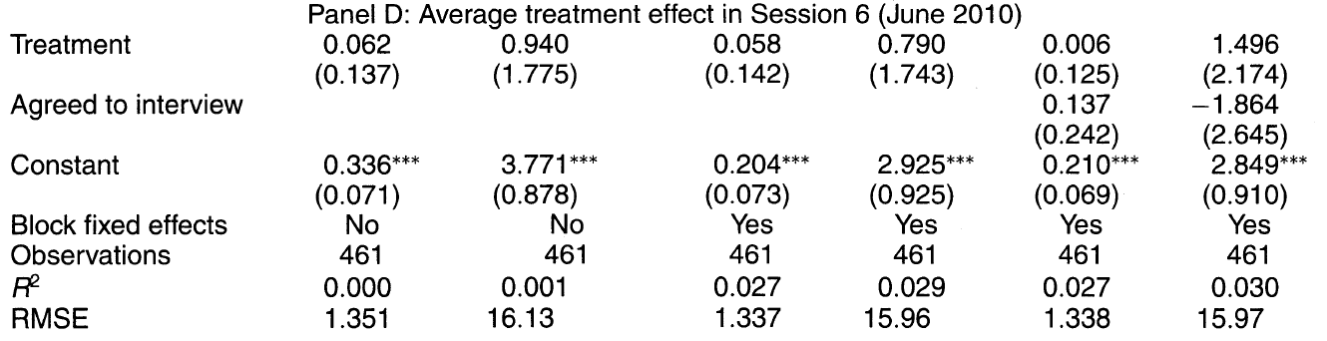
Direct Effects: ATE

